Slide 1
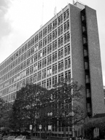
68 PLC, 541-346-3226
http://tlc.uoregon.edu

Slide 2
Courses
Topics include speed reading, test taking,
critical thinking, time management, and more.
Courses provide elective credit toward degree.
Short courses (3 weeks long) and late start
courses allow greater flexibility.

Slide 3
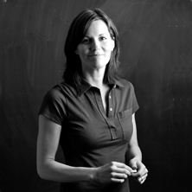
Individual Meetings
Weekly drop-in sessions
with TLC instructors to work
on study skills and statistics
Schedule individual
appointments with
TLC instructors

Slide 4
Math and Writing Labs
Free, drop-in help Monday – Friday, 9am-4pm in 72 PLC
Labs are open week two of the term through the Wednesday of finals week.

Slide 5
Tutoring
Group tutoring offers consistent help throughout the term. Groups of six or fewer students meet two hours per week ($125/term).
Private tutoring ($9 - $13/hour) for lower-division math, foreign language and science courses

Slide 6
Standardized Exam Preparation
GRE, GMAT, MCAT and LSAT preparation workshops provide
high-quality, low-cost alternative
to commercial programs.

Slide 7
Health Professions Program
Thinking about a career in the health field?
Explore,
plan,
prepare,
and apply!
We can help you…
Chart your coursework
Connect with your community
Locate internships
Find research opportunities
Secure faculty references
Complete grad school apps
Research funding sources

Slide 8
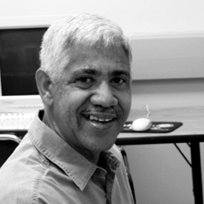
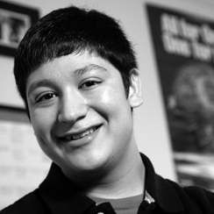
Courses, conferences, labs, tutoring, and standardized exam preparation are available to all UO students!

Slide 9
TRiO
Two grant-funded programs
for eligible undergraduates
Student Support Services
McNair Scholars Program

Slide 10
Student Support Services
Eligibility
First-generation college student
Low-income background
Documented disability
Academic need
and commitment to
graduating from the UO
Comprehensive support
Advising and graduation planning
Academic assistance workshops, courses and tutors
Financial literacy and funding opportunities
Study area with computers and printer

Slide 11
Student Support Services
Learn more and print an application at
http://tlc.uoregon.edu/sss

Slide 12
McNair Scholars Program
Eligibility
Junior or senior
Motivated to earn a PhD
Competitive GPA
US citizen/permanent resident
Low-income/first-generation college student or member of an under-represented ethnic group
Benefits
Scholarships
Summer research stipends
Focused courses
Faculty mentor connection
Workshops on funding
Preparation for the GRE

Slide 13
McNair Scholars Program
Learn more and print an application at
http://tlc.uoregon.edu/mcnair

Slide 14
TLC: click, call, or visit
If you are a strong student, you may find ways to make your studies more efficient.
If you are a struggling student, you may be just one or two study skills away from success.
http://tlc.uoregon.edu
541-346-3226, 68 PLC

